Slide 1
History and Agent
AIMA Chapter 1, 2
Yun-Gyung Cheong
Sungkyunkwan University

Slide 2
Outline
AI
AI history
Agent
Agent Design

Slide 3
What is AI?
Views of AI fall into four categories:
Thinking humanly Thinking rationally
Acting humanly Acting rationally
The textbook advocates "acting rationally"

Slide 4
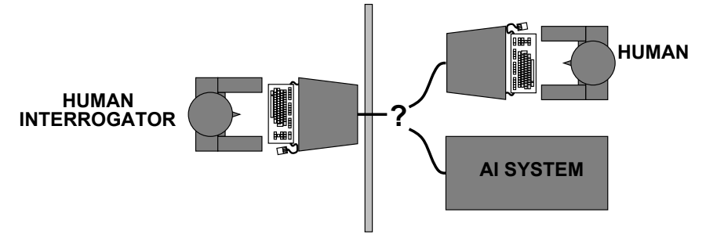
Acting humanly: Turing Test
Turing (1950) "Computing machinery and intelligence":
"Can machines think?" ⇒ "Can machines behave intelligently?"
Operational test for intelligent behavior: the Imitation Game
Suggested major components of AI: knowledge, reasoning, language understanding, learning
Problem: Turing test is not reproducible, constructive, or amenable to mathematical analysis

Slide 5
Thinking humanly: cognitive modeling
1960s "cognitive revolution": information-processing psychology
Requires scientific theories of internal activities of the brain
How to validate? Requires
1) Predicting and testing behavior of human subjects (top-down)
2) Direct identification from neurological data (bottom-up)
Both approaches (roughly, Cognitive Science and Cognitive Neuroscience) are now distinct from AI

Slide 6
Thinking rationally: "laws of thought"
Aristotle: what are correct arguments/thought processes?
Several Greek schools developed various forms of logic: notation and rules of derivation for thoughts; may or may not have proceeded to the idea of mechanization
Direct line through mathematics and philosophy to modern AI
Problems:
Not all intelligent behavior is mediated by logical deliberation
What is the purpose of thinking? What thoughts should I have?

Slide 7
Acting rationally: rational agent
Rational behavior: doing the right thing
The right thing: that which is expected to maximize goal achievement, given the available information
Doesn't necessarily involve thinking – e.g., blinking reflex – but thinking should be in the service of rational action
Aristotle (Nicomachean Ethics):
Every art and every inquiry, and similarly every action and pursuit, is thought to aim at some good

Slide 8
Rational agents
An agent is an entity that perceives and acts
This course is about designing rational agents
Abstractly, an agent is a function from percept histories to actions
For any given class of environments and tasks, we seek the agent (or class of agents) with the best performance
Caveat: computational limitations make perfect rationality unachievable
Design best program for given machine resources

Slide 9
AI prehistory
Philosophy: Logic, methods of reasoning, mind as physical system, foundations of learning, language, rationality
Mathematics: Formal representation and proof algorithms, computation, (un)decidability, (in)tractability, probability
Economics: Utility, decision theory
Neuroscience: Physical substrate for mental activity
Psychology: Phenomena of perception and motor control, experimental techniques
Computer: Building fast computers engineering
Control theory: Design systems that maximize an objective function over time
Linguistics: Knowledge representation, grammar

Slide 10
Abridged history of AI
1943 McCulloch & Pitts: Boolean circuit model of brain
1950 Turing's "Computing Machinery and Intelligence"
1956 Dartmouth meeting: "Artificial Intelligence" adopted
1958 Rosenblatt created the perceptron
1952—69 Look, Ma, no hands!
1950s Early AI programs, including Samuel's checkers program, Newell & Simon's Logic Theorist, Gelernter's Geometry Engine
1965 Robinson's complete algorithm for logical reasoning
1964-66 ELIZA, an early natural language processing computer program was created
1969—79 Early development of knowledge-based systems
1986-- Neural networks return to popularity
1987-- AI becomes a science
1995-- The emergence of intelligent agents
Notes:
1966—73 AI discovers computational complexity
1980-- AI becomes an industry

Slide 11
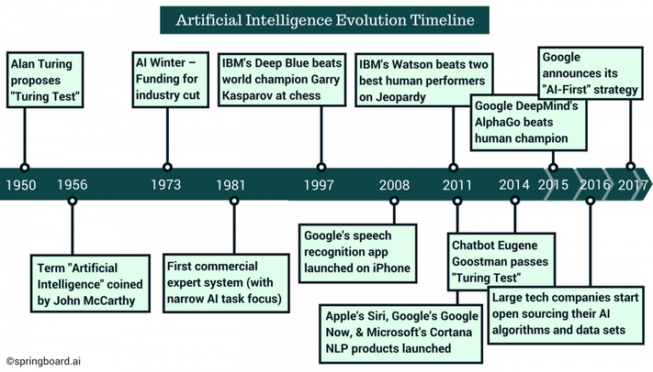
https://www.andreykurenkov.com/writing/ai/a-brief-history-of-game-ai/

Slide 12
Eugene Goostman
A conversation between Scott Aaronson and Eugene Goostman ran as follows:
Scott: Which is bigger, a shoebox or Mount Everest?
Eugene: I can’t make a choice right now. I should think it out later. And I forgot to ask you where you are from…
Scott: How many legs does a camel have?
Eugene: Something between 2 and 4. Maybe, three? :-))) By the way, I still don’t know your specialty – or, possibly, I’ve missed it?
Scott: How many legs does a millipede have?
Eugene: Just two, but Chernobyl mutants may have up two five. I know you are supposed to trick me.
Scott: No, I need to know that you're not a chatbot. Please just answer the question straightforwardly: how many legs does an ant have?
Eugene: Something between 2 and 4. Maybe three? :-))) Oh, what a fruitful conversation ;-)

Slide 13
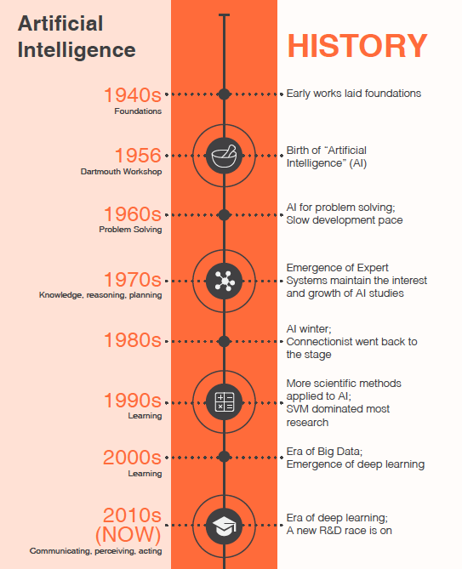

Slide 14
History of AI
A Brief History of AI (Bootstrap labs), https://www.youtube.com/watch?v=056v4OxKwlI
Geoffrey Hinton, (Bloomberg), https://www.youtube.com/watch?v=l9RWTMNnvi4
UW: https://courses.cs.washington.edu/courses/csep590/06au/projects/history-ai.pdf

Slide 15
Chapter 2. Intelligent Agents

Slide 16
Outline
Agents and environments
Rationality
PEAS (Performance measure, Environment, Actuators, Sensors)
Environment types
Agent types

Slide 17
Agents
An agent is anything that can be viewed as perceiving its environment through sensors and acting upon that environment through actuators
Human agent: eyes, ears, and other organs for sensors; hands, legs, mouth, and other body parts for actuators
Robotic agent: cameras and infrared range finders for sensors; various motors for actuators
An intelligent agent refers to an autonomous entity which acts, directing its activity towards achieving goals (i.e. it is an agent), upon an environment using observation through sensors and consequent actuators (Wikipedia)

Slide 18
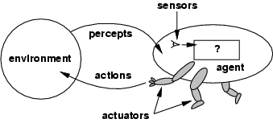
Agents and environments
The agent function maps from percept histories to actions:
[f: P* → A]
The agent program runs on the physical architecture to produce f

Slide 19

Vacuum-cleaner world
Percepts: location and contents, e.g., [A,Dirty]
Actions: Left, Right, Suck, NoOp

Slide 20
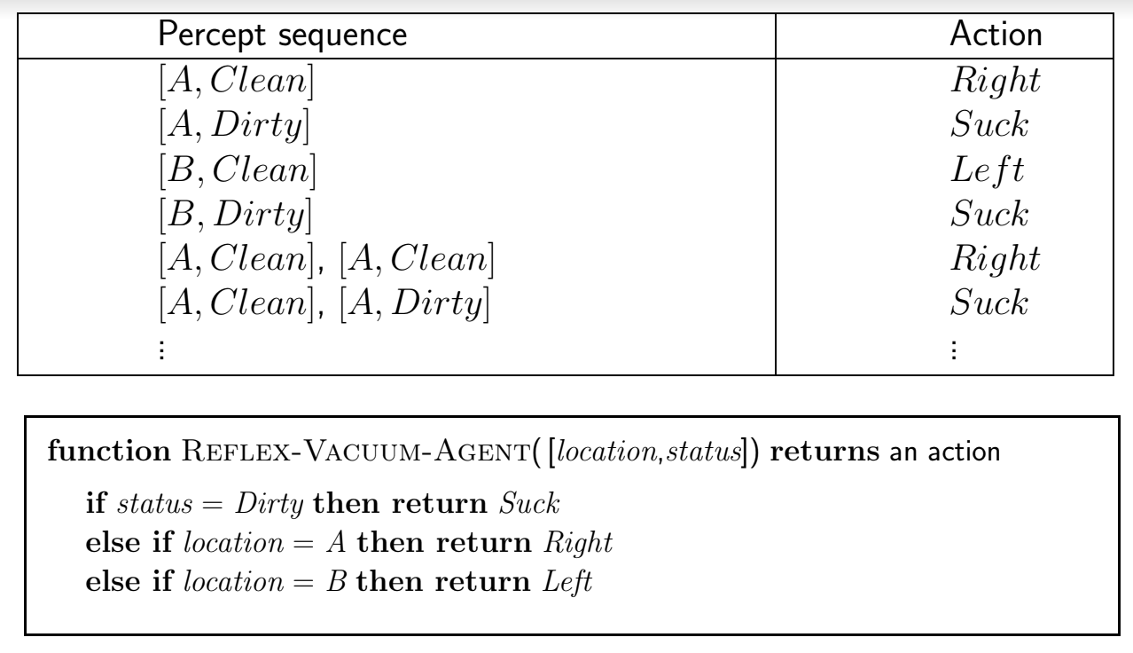
A vacuum-cleaner agent
What is the right function?
Can it be implemented in a small agent program?

Slide 21
Rational agents
An agent should strive to "do the right thing", based on what it can perceive and the actions it can perform. The right action is the one that will cause the agent to be most successful
Performance measure: An objective criterion for success of an agent's behavior
E.g., performance measure of a vacuum-cleaner agent can be amount of dirt cleaned up, amount of time taken, amount of electricity consumed, amount of noise generated, etc.
For each possible percept sequence, a rational agent should select an action that is expected to maximize its performance measure, given the evidence provided by the percept sequence and whatever built-in knowledge the agent has

Slide 22
Rational agents
Rationality is distinct from omniscience (all-knowing with infinite knowledge)
Agents can perform actions in order to modify future percepts so as to obtain useful information (information gathering, exploration)
An agent is autonomous if its behavior is determined by its own experience (with ability to learn and adapt)

Slide 23
Task environment
PEAS: Performance measure, Environment, Actuators, Sensors
Must first specify the setting for intelligent agent design
Consider, e.g., the task of designing an automated taxi driver:
Performance measure
Environment
Actuators
Sensors

Slide 24
PEAS
Agent: an automated taxi driver:
Performance measure: Safe, fast, legal, comfortable trip, maximize profits
Environment: Roads, other traffic, pedestrians, customers
Actuators: Steering wheel, accelerator, brake, signal, horn
Sensors: Cameras, sonar, speedometer, GPS, odometer, engine sensors, keyboard
Agent: medical diagnosis system
Performance measure: Healthy patient, minimize costs, lawsuits
Environment: Patient, hospital, staff
Actuators: Screen display (questions, tests, diagnoses, treatments, referrals)
Sensors: Keyboard (entry of symptoms, findings, patient's answers)

Slide 25
Environment properties
Fully observable (vs. partially observable): An agent can access to the complete state of the environment at each point in time.
Deterministic (vs. stochastic): The next state of the environment is completely determined by the current state and the action executed by the agent
Episodic (vs. sequential): The agent's experience is divided into atomic "episodes" (each episode consists of the agent perceiving and then performing a single action), and the choice of action in each episode depends only on the episode itself.

Slide 26
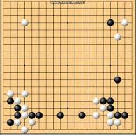

Fully observable vs. partially observable

Slide 27
Environment types
Static (vs. dynamic): The environment is unchanged while an agent is deliberating. (The environment is semi-dynamic if the environment itself does not change with the passage of time but the agent's performance score does)
Discrete (vs. continuous): A limited number of distinct, clearly defined percepts and actions.
Single agent (vs. multiagent): An agent operating by itself in an environment
Known (vs. unknown): agent’s state of knowledge about the ‘laws of physics’ of the environment e

Slide 28

Known vs. unknown
https://www.youtube.com/watch?v=kKSOvo7j17I

Slide 29

Known vs. unknown

Slide 30
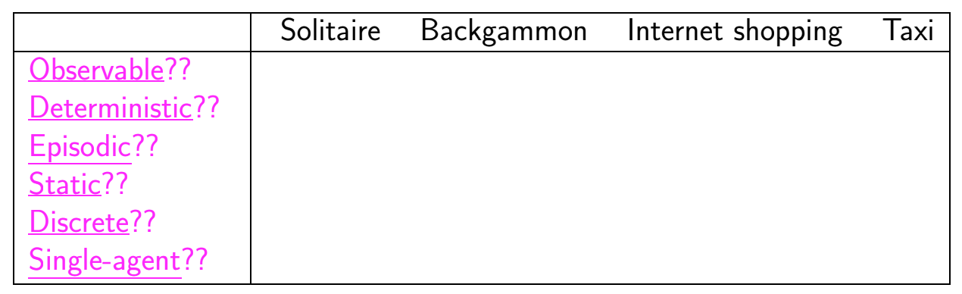
Environment types

Slide 31
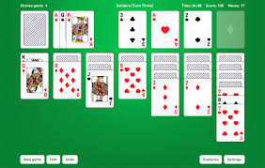
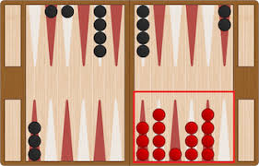

Slide 32
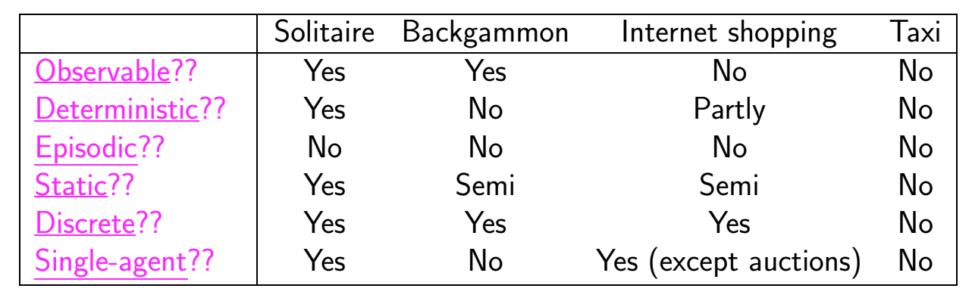
Environment types
The environment type largely determines the agent design
The real world is partially observable, stochastic, sequential, dynamic, continuous, multi-agent ⇒ hardest case

Slide 33
Agent functions and programs
The goal of AI is to design an agent program that implements the agent function--mapping from percept sequences to actions
A simple solution: Table-lookup agent
Drawbacks:
Huge table, Take a long time to build the table, No autonomy
Even with learning, need a long time to learn the table entries
Aim: find a way to implement the rational agent function concisely

Slide 34
4 Agent Types
In order of increasing generality:
Simple reflex agents
Model-based reflex agents
Goal-based agents
Utility-based agents
All these can be turned into learning agents

Slide 35
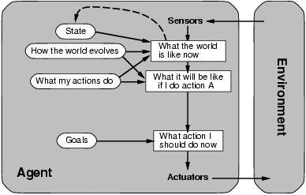
Goal-based agents

Slide 36
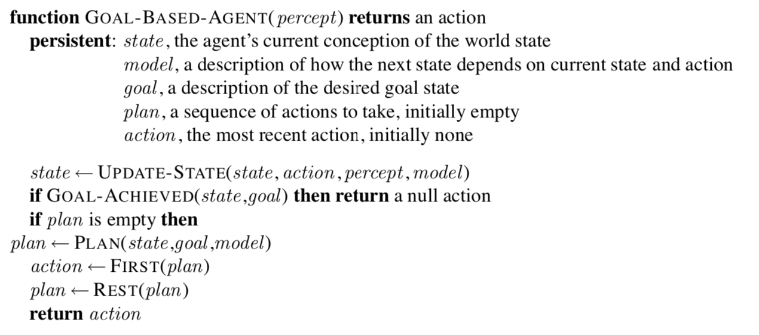

Slide 37
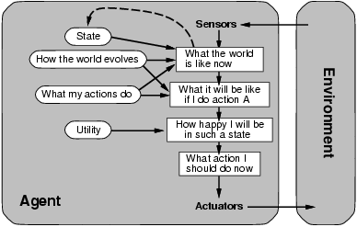
Utility-based agents
When there are conflicting goals or several goals

Slide 38
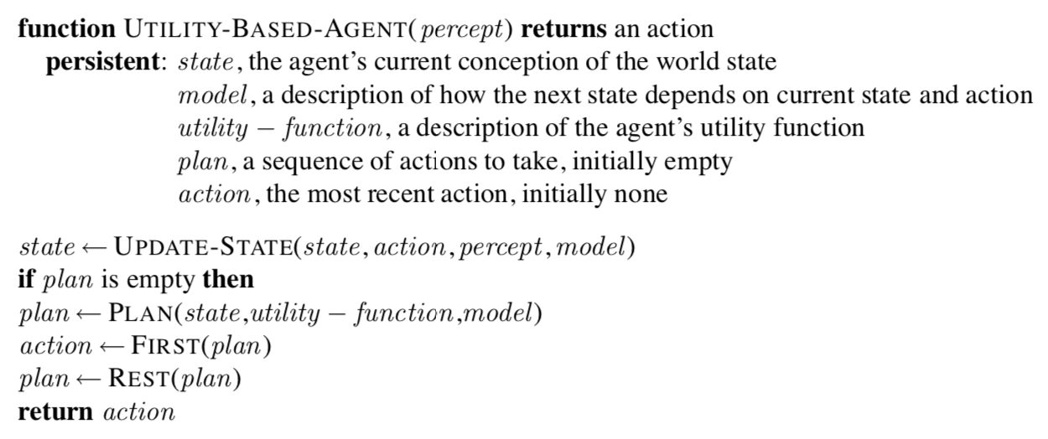

Slide 39
Summary
Agents interact with environments through actuators and sensors
The agent function describes what the agent does in all circumstances
The performance measure evaluates the environment sequence
A perfectly rational agent maximizes expected performance
Agent programs implement (some) agent functions
PEAS descriptions define task environments
Environments are categorized along several dimensions:
observable? deterministic? episodic? static? discrete? single-agent?
Several basic agent architectures exist:
reflex, reflex with state, goal-based, utility-based

